Slide 1
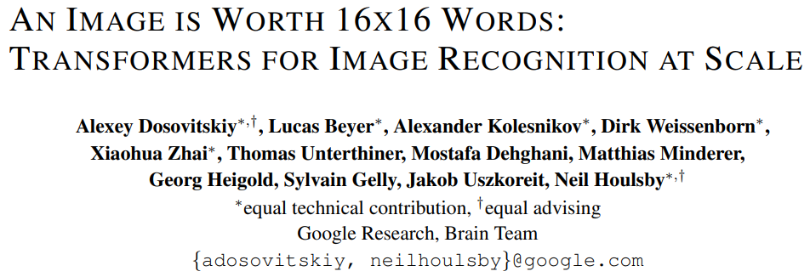

Slide 2

Vision Transformer (ViT)
When trained on Imagenet, it provides less accuracy than ResNet....
Because, Transformers lack some of the inductive biases inherent to CNNs, such as translation equivariance and locality, and therefore do not generalize well when trained on inshfficient amounts of data.
=> Pretrain large-scale datasets (14M - 300M).
Vision Transformer attains excellent results when pretrained at sufficient scale and transferred to tasks with fewer datapoints.

Slide 3
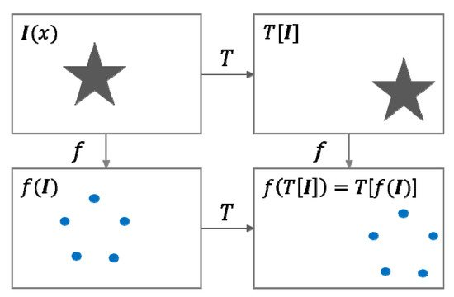
Translational Equivariance

Slide 4
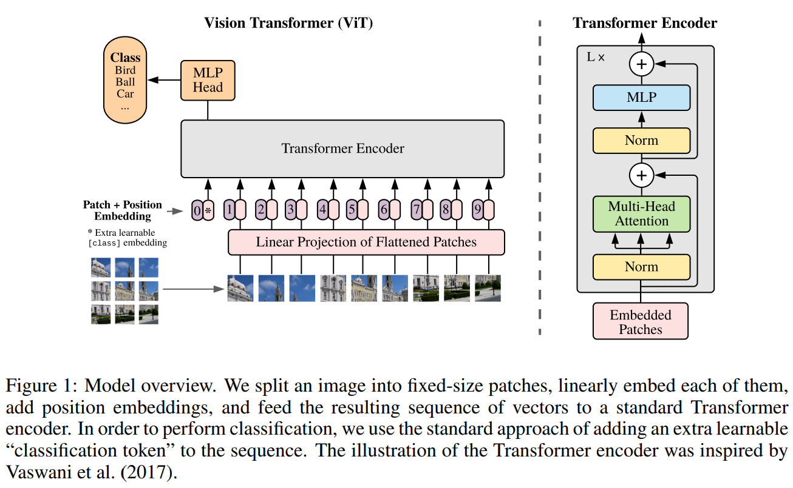
ViT

Slide 5

ViT

Slide 6
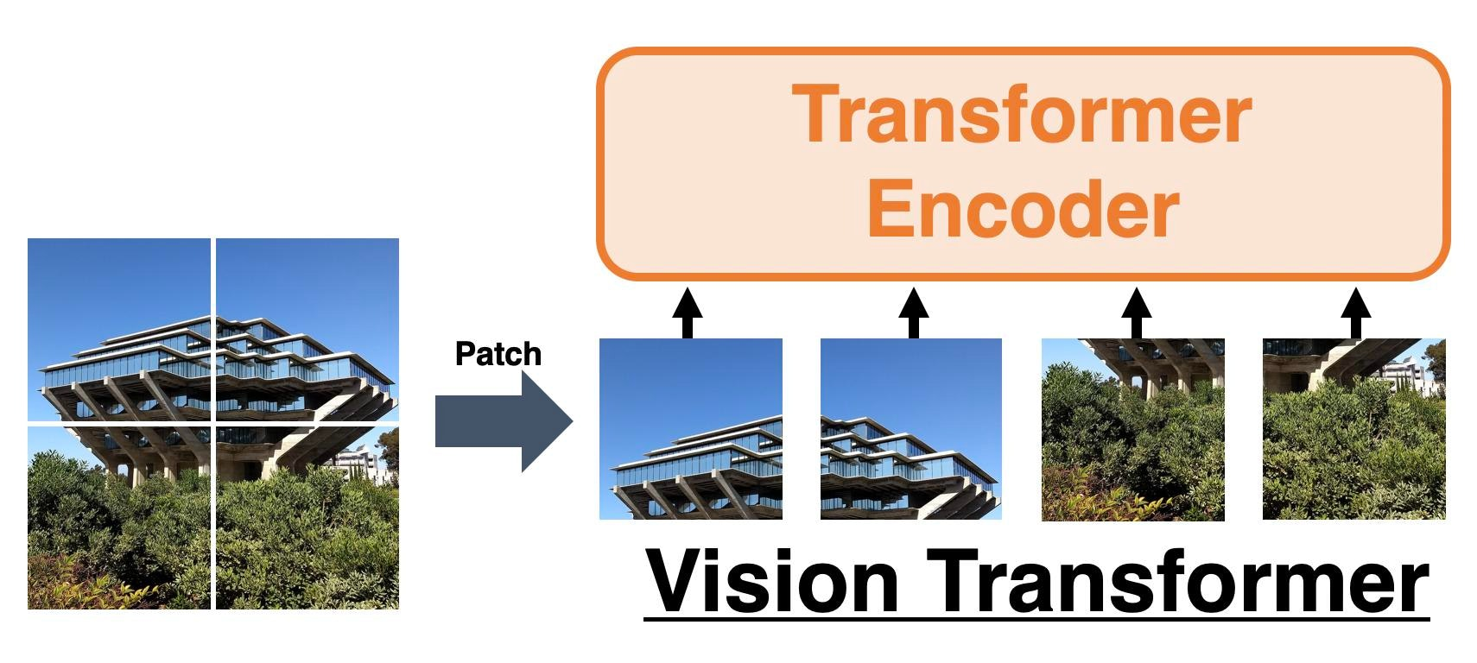
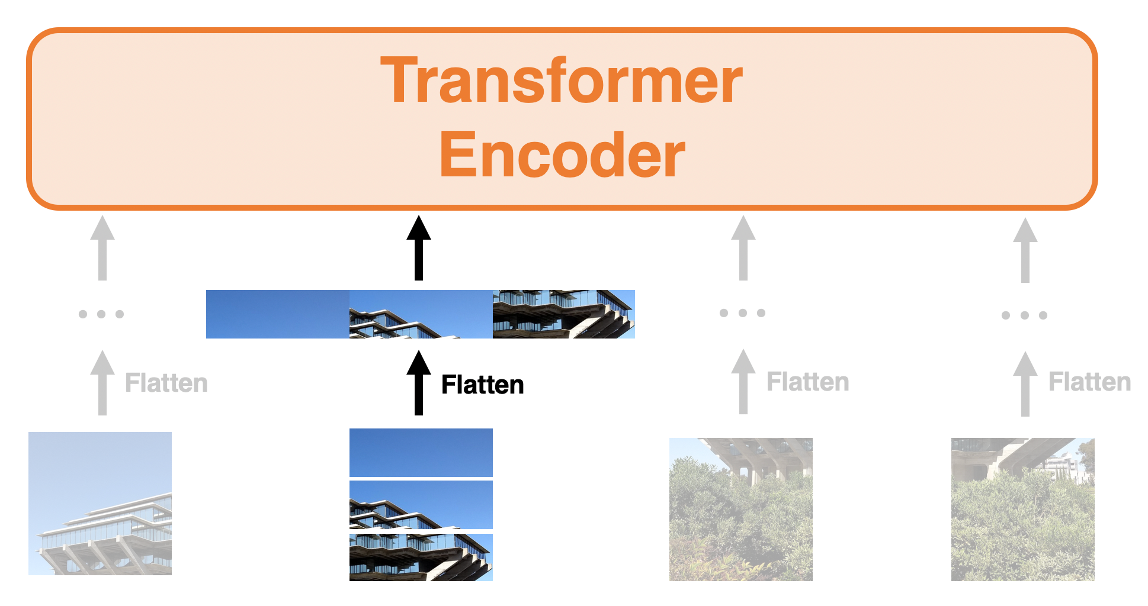
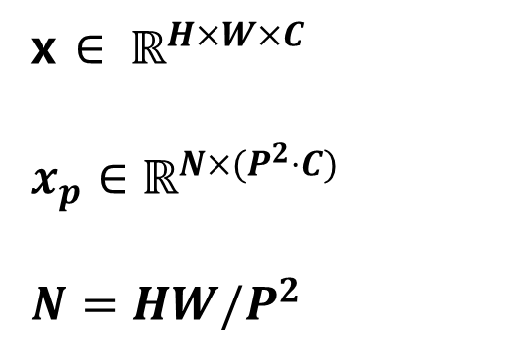
ViT - Input Section
x $∈ ℝ^{H×W×C}$
$x_{p}∈ℝ^{N×(P^{2}⋅C)}$
$N=HW/P^{2}$

Slide 7
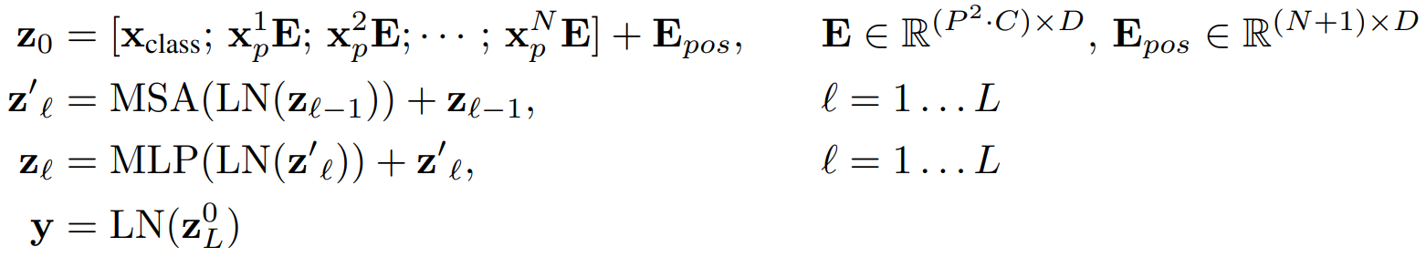
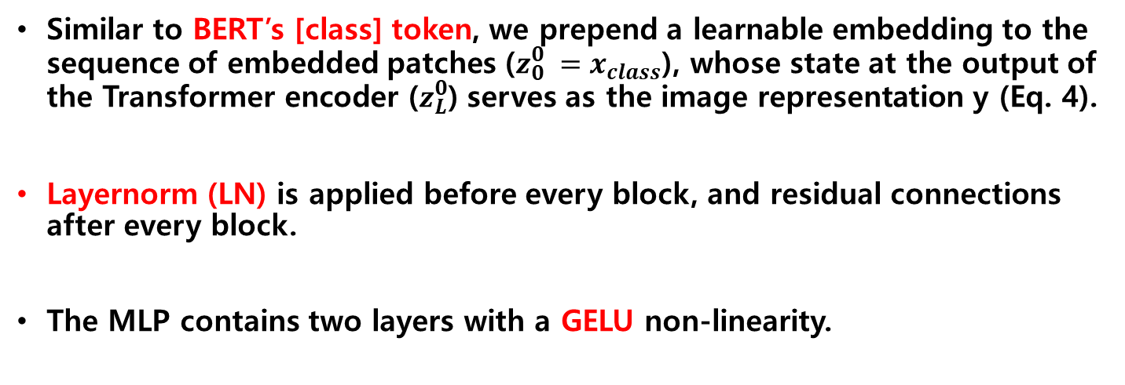
ViT - Transformer Encoder
Similar to BERT’s [class] token, we prepend a learnable embedding to the sequence of embedded patches ($z_{0}^{0} =x_{class}$), whose state at the output of the Transformer encoder ($z_{L}^{0}$) serves as the image representation y (Eq. 4).
Layernorm (LN) is applied before every block, and residual connections after every block.
The MLP contains two layers with a GELU non-linearity.
CLS token
Hybrid Architecture : Raw image patches --> Feature map of a CNN

Slide 8
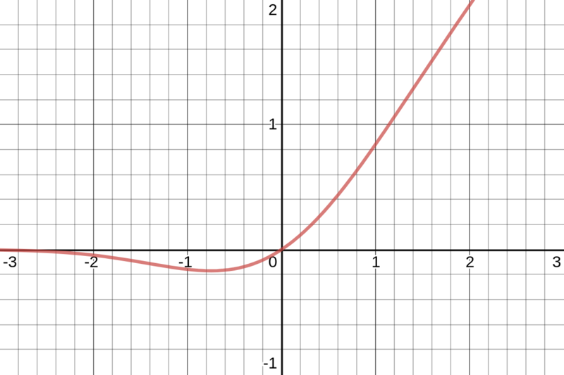
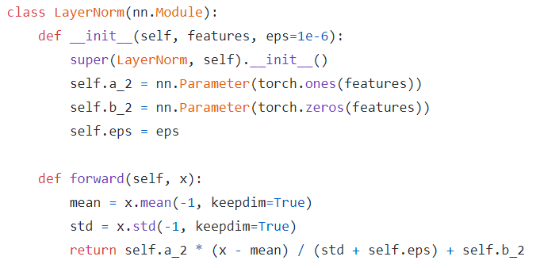
LN & GELU
LN
GELU

Slide 9
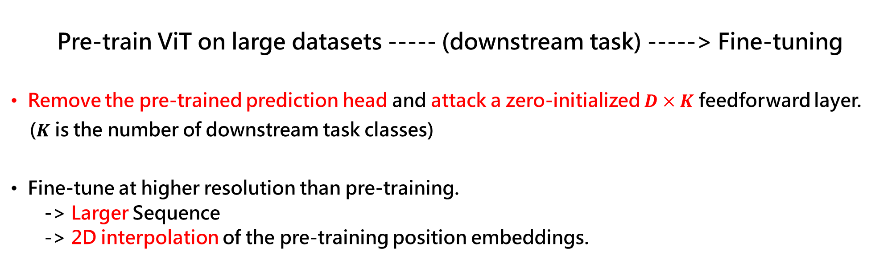
ViT - Fine-tuning and Higher Resolution
Pre-train ViT on large datasets ----- (downstream task) -----> Fine-tuning
Remove the pre-trained prediction head and attack a zero-initialized $D×K$ feedforward layer.
($K$ is the number of downstream task classes)
Fine-tune at higher resolution than pre-training.
-> Larger Sequence
-> 2D interpolation of the pre-training position embeddings.
N
N + k

Slide 10
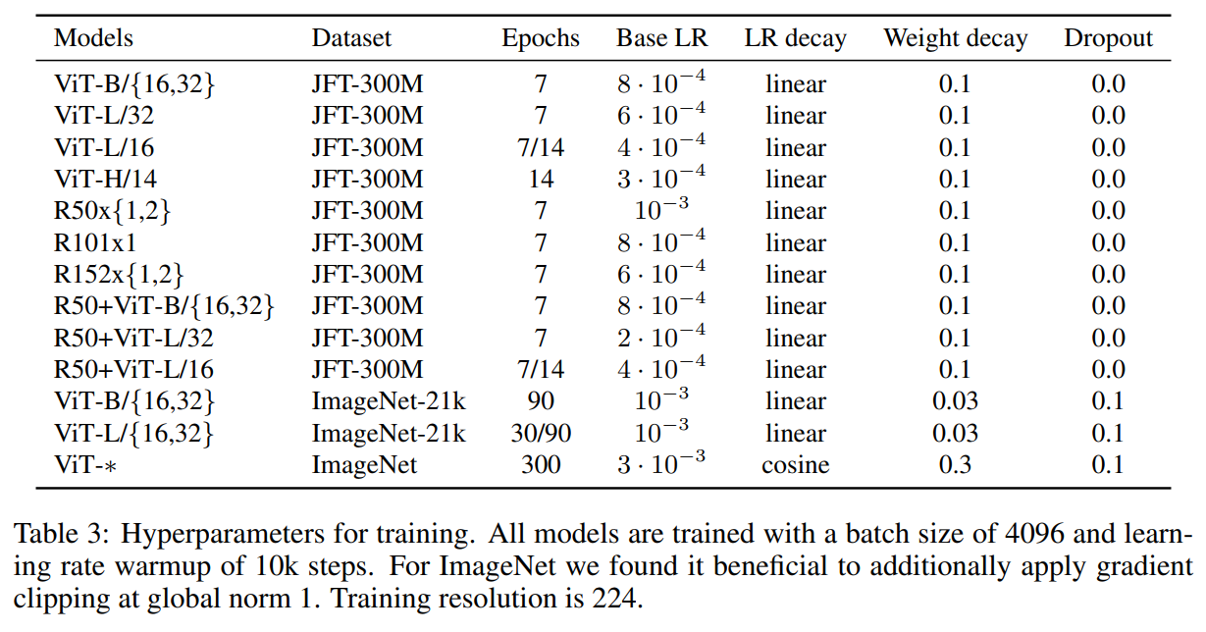
Experiments - Training
patch size

Slide 11
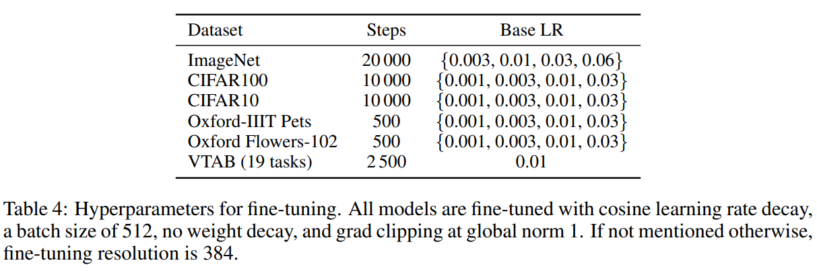
Experiments - Finetuning

Slide 12
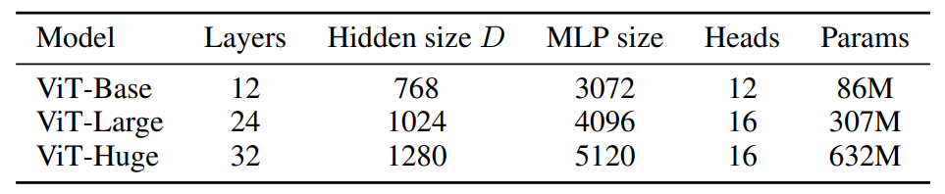
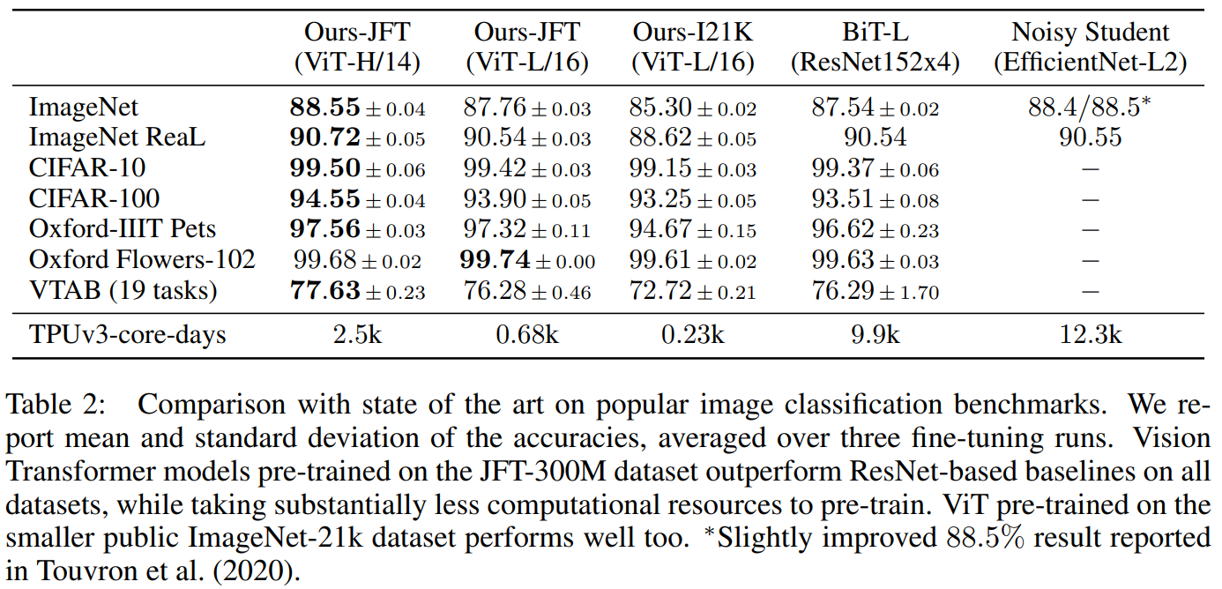

Slide 13
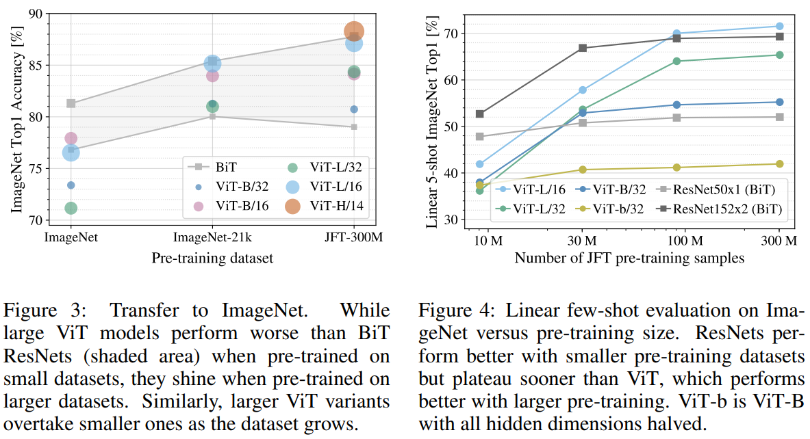

Slide 14
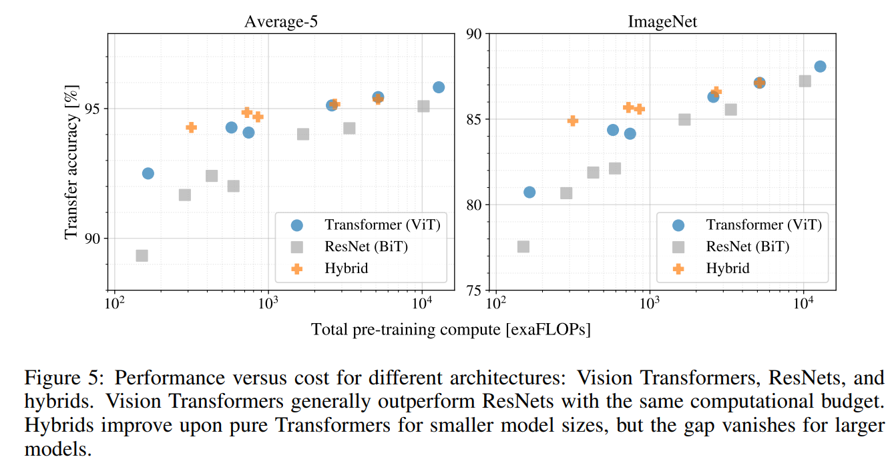

Slide 15
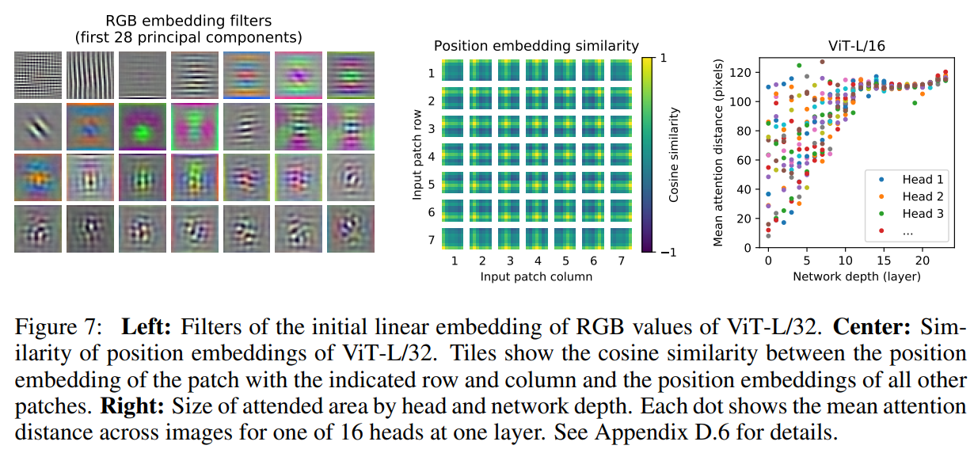
Inspecting vision transformer

Slide 16

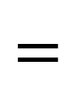
Embedding
W
P1
P2
Filter
H
W
$$=$$
$$⊛$$
P3
P4
H

Slide 17
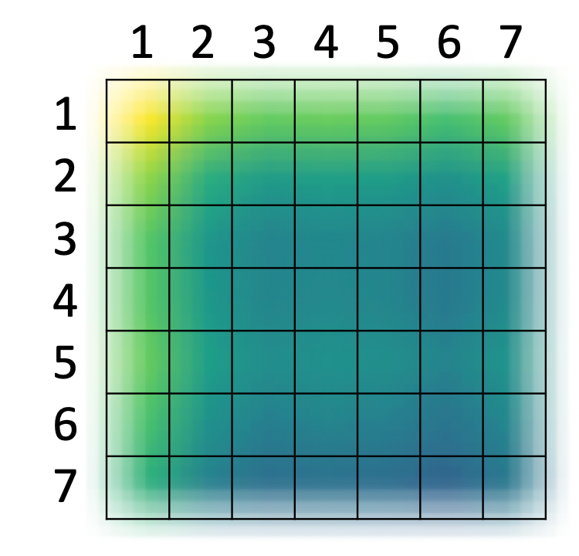

https://engineer-mole.tistory.com/133

Slide 18
Specifically, we compute the average distance in image space across which information is integrated, based on the attention weights
Attention Distance == Receptive Field
Shallower : Local Feature and Global Feature
Deeper : Global Feature

Slide 19
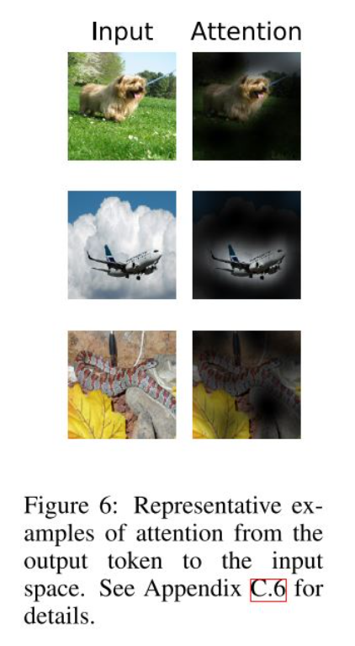
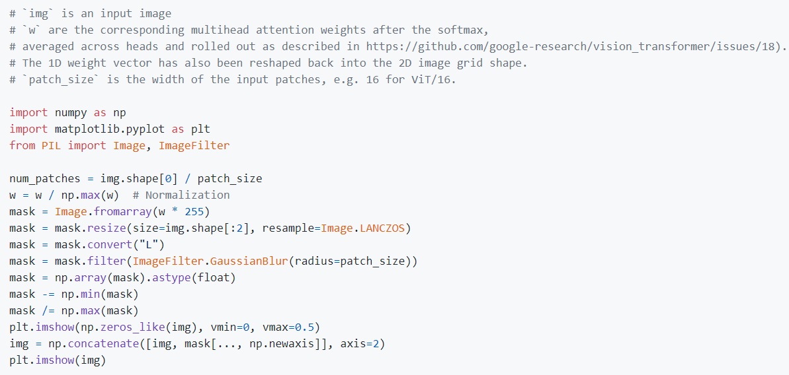

Slide 20
Challenge
One is to apply ViT to other computer vision tasks, such as detection and segmentation.
Another challenge is to continue exploring self-supervised pre-training methods.
Finally, further scaling of ViT would likely lead to improved performance.

